Slide 1


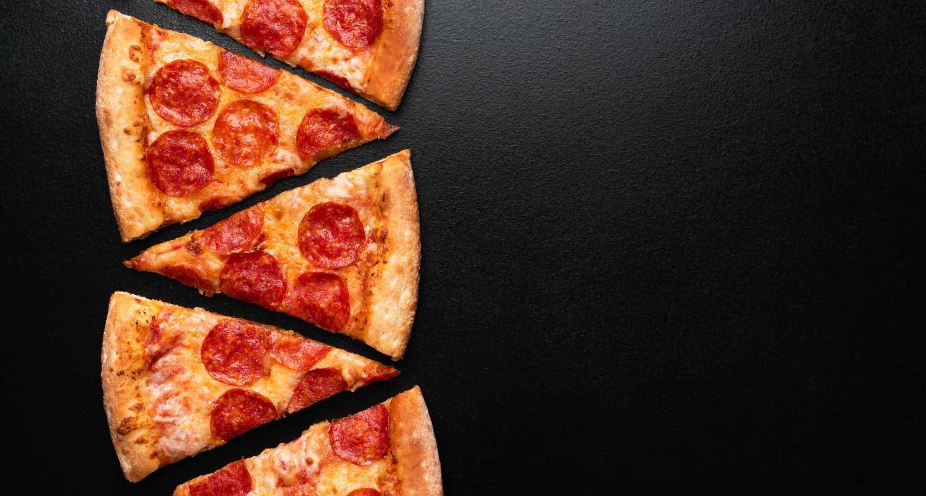
Problem Statement: Pizza Ordering System
Made by:
Ahmet Arda Öz
Melisa Karadağ

Slide 2
Current Situation
In these days there are so many applications for the pizza ordering system and thanks for the internet the customers can found whatever they want.
But this situation have a problem:
The creativity will not be so effective in menu system this means in the other systems the customer can choose certain menus.

Slide 3
Objectives
The program must provide :
User friendly interface,
Support creativity for customer,
Support material variety,
Can calculate total bill.

Slide 4
Functional requirements
The customer can create their own menu with our materials.
If they don’t want to crate they can also choose certain menus which we created for them.

Slide 5
Nonfunctional requirements
The system must support:
3 different menus,
10 ingredients,
Pizza dough thickness,
It must be available whenever customer wants.

Slide 6
Target Environment
The customers can reach the program in their own main screens only using a shortcut.
The program can be use with any java ide.
The apps used:
The program language is java.
The main Ide is intellij idea.

Slide 7
Project schedule
Project-kick off Feb 14
System review March 10
Review of first prototype april 12
Client acceptance may 15

Slide 8
Client Acceptance Criteria
When the customer give the order of pizza the average response time reply must be less then 1 second.

